Slide 1
BIT 353 ARTIFICIAL INTELLIGENCE
Lecturer: Saroj Poudel
Qualification: MS CIS&IT
Profession: Senior Software Developer/CTO
Lincoln University College, CN 1221

Slide 2


Overview
The subject will cover the foundations of modern artificial intelligence (AI) and many of the key ideas that have resonated throughout its history.
It will focus on concepts that are not only important in the space of AI but are also practically useful in modern applications.
We will practice effective methods of reasoning about AI problems, which will generalize beyond the specific topics we study in class.

Slide 3
Topics to be covered
Introduction to problems
Problem searching by search
Example Problems
Search Algorithms

Slide 4
Problem Solving Agent
When the correct action to take is not immediately obvious, an agent may need to plan ahead: to consider a sequence of actions that form a path to a goal state. Such an agent is called a problem-solving agent.
The computational process the agent undertakes is called search.

Slide 5
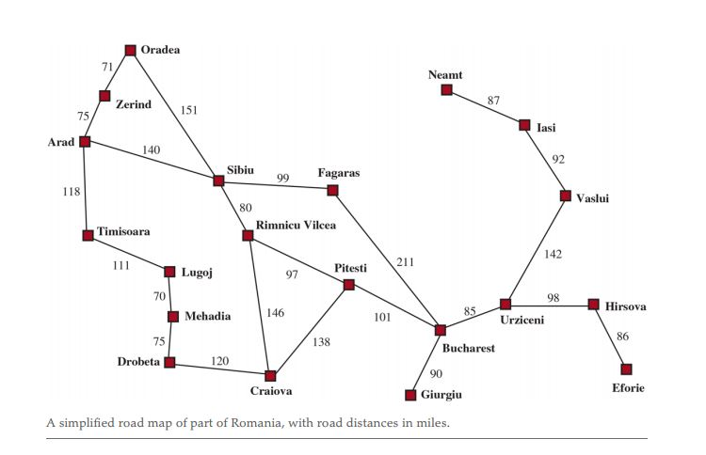

Slide 6
In the above map suppose the agent is currently in the city of Arad and has a nonrefundable ticket to fly out of Bucharest the following day.
Goal Formulation: The agent adopts the goal of reaching Bucharest. Goals organize behavior by limiting the objectives and hence the actions to be considered.
Problem formulation: The agent devises a description of the states and actions necessary to reach the goal—an abstract model of the relevant part of the world. For our agent, one good model is to consider the actions of traveling from one city to an adjacent city, and therefore the only fact about the state of the world that will change due to an action is the current city.

Slide 7
SEARCH: Before taking any action in the real world, the agent simulates sequences of actions in its model, searching until it finds a sequence of actions that reaches the goal.
Solution: The sequence of action performed to reach the goal is called a solution.
The agent might have to simulate multiple sequences that do not reach the goal, but eventually it will find a solution.
Execution: The agent can now execute the actions in the solution, one at a time.
It is an important property that in a fully observable, deterministic, known environment, the solution to any problem is a fixed sequence of actions. In our case, drive to Sibiu, Rimniciu, Pitesti then Bucharest.

Slide 8
Search Problems and Solutions
A search problem can be formally described as:
State space: A set of possible states that the environment can be in.
Initial State: Where the agent starts. Example: Arad
A set of one or more goal states. Sometimes there is one goal state (e.g., Bucharest), sometimes there is a small set of alternative goal states, and sometimes the goal is defined by a property that applies to many states (potentially an infinite number). Example: Vaccum Cleaner
The actions available to the agent. Given a state ACTIONS returns a finite set of actions that can be executed in s.
ACTIONS(Arad) = {ToSibiu, ToTimisoara, ToZerind}.

Slide 9
A transition model, which describes what each action does. RESULT returns the state that results from doing action in state For example,
RESULT(Arad, ToZerind) = Zerind
An action cost function, denoted by ACTION-COST(s,a,s’) when we are programming or when we are doing math, that gives the numeric cost of applying action in state s to reach state s’. For example, for route-finding agents, the cost of an action might be the length in miles.
A sequence of actions forms a path, and a solution is a path from the initial state to a goal state.
An optimal solution has the lowest path cost among all solutions.

Slide 10
Formulating Problems
Our formulation of the problem of getting to Bucharest is a model—an abstract mathematical description—and not the real thing.
Compare the simple atomic state description Arad to an actual cross-country trip, where the state of the world includes so many things: the traveling companions, the current radio program, the scenery out of the window, the weather, the traffic, and so on.
The process of removing detail from a representation is called abstraction.
The choice of a good abstraction involves removing as much detail as possible while retaining validity and ensuring that the abstract actions are easy to carry out.

Slide 11
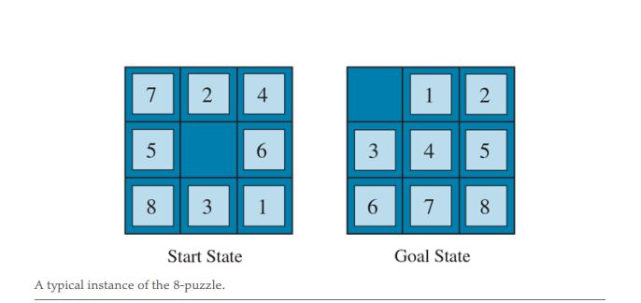
Example Problems

Slide 12
STATES: A state description specifies the location of each of the tiles.
INITIAL STATE: Any state can be designated as the initial state.
ACTIONS: moving Left, Right, Up, or Down. If the blank is at an edge or corner then not all actions will be applicable.
TRANSITION MODEL: Maps a state and action to a resulting state; for example, if we apply Left to the start state in above figure , the resulting state has the 5 and the blank switched.
GOAL STATE: Although any state could be the goal, we typically specify a state with the numbers in order, as in above figure on right.
ACTION COST: Each action costs 1.

Slide 13
Search Algorithms
A search algorithm takes a search problem as input and returns a solution, or an indication of failure.
In this chapter we use search tree to solve problems.
Each node in the search tree corresponds to a state in the state space and the edges in the search tree correspond to actions.
The root of the tree corresponds to the initial state of the problem.

Slide 14
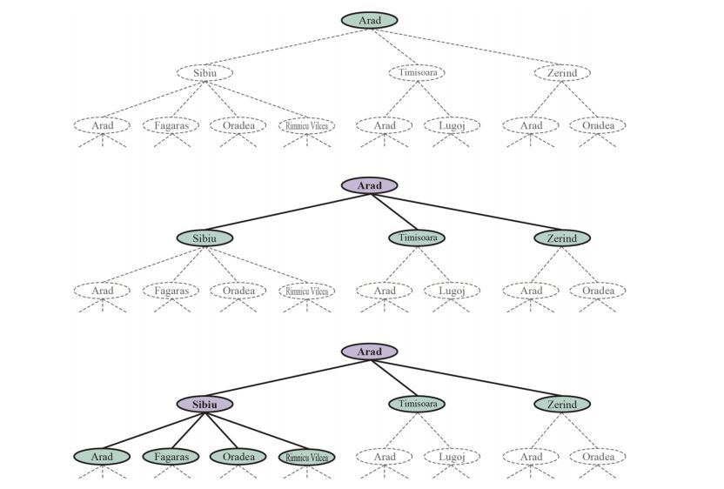

Slide 15
The above figure shows the first few steps in finding a path from Arad to Bucharest.
The root node of the search tree is at the initial state, Arad.
We can expand the node, by considering the available ACTIONS for that state, using the RESULT function to see where those actions lead to, and generating a new node (called a child node or successor node) for each of the resulting states.
Each child node has Arad as its parent node.
Now we must choose which of these three child nodes to consider next.
This is the essence of search—following up one option now and putting the others aside for later.

Slide 16
Next topic:
Uninformed Search- BFS, Uniformed Cost Search, DFS

